Slide 1
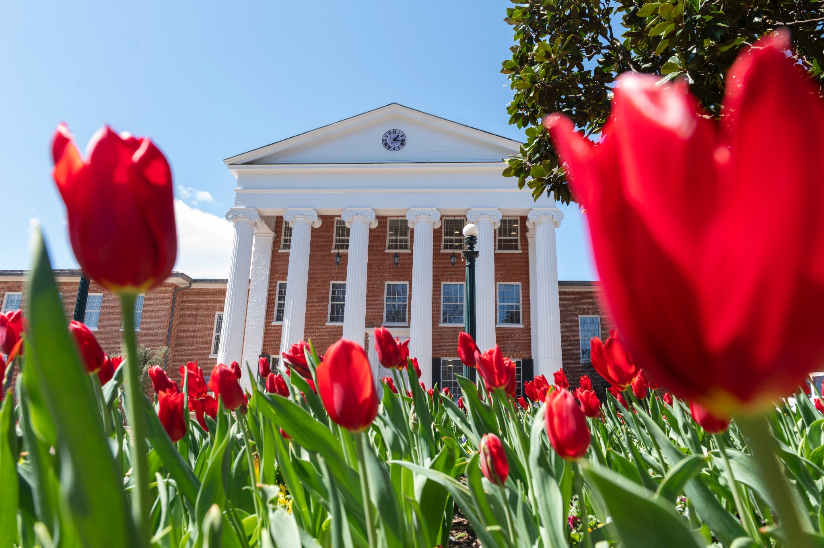

Student Success in Sustainability
Resources and Opportunities for Student Academic and Professional Development in the Field of Sustainability

Slide 2
Agenda
Office of Sustainability Introduction
Resources and Opportunities for Students
How to Become a Professional
Getting Involved in the Community
Questions

Slide 3
Office of Sustainability
Associate Director
John Brugge
brugge@olemiss.edu
Lead Undergraduate Student Sustainability Fellow
Hailey Smith
hrsmith8@go.olemiss.edu
sustainability@olemiss.edu
The mission of the Office of Sustainability is to be a catalyst for environmentally positive change by educating, connecting and empowering the members of our community for the wellbeing of people and our ecological systems.

Slide 4
Student Resources

Slide 5
Academic Programs
Environmental Studies, B.A.
10 hours of required introductory courses
9 hours of core electives
3 hours of internship
1 hour capstone course
15 hours of electives
Students must also complete a minor
Environmental Studies, Minor
Envs 101 or Envs 301
15 credit hours of approved electives
minimum of 3 hours in the social sciences
minimum of 3 hours in the natural sciences

Slide 6
Project Funding and Support
UM Green Fund
Rolling applications
Variable prize amounts
Improve sustainability and stakeholder quality of life
Community Partnership Grant
2025 Deadline: December 1
Up to $1,000
Student, faculty, and staff projects
Stamps Impact Prize
Fall Deadline: November 1
Up to $5,000
Enrich student experiences
EPA P3 Student Design Competition
2026 Deadline: February
Up to $75,000
Scientific and engineering environmental projects

Slide 7

Capstone Support
Work with our team to develop your capstone project. Topics could include:
Civics and Sustainability in Oxford
Gamification
Next-Gen Compost Production & Digitalization
Recycling Behavior & Process
Southern Sustainability
Ole Miss Sustainability Report

Slide 8
Project Funding and Support
Honors College Barksdale Award
2025 Deadline: December 5
Up to $5,000
Two awardees per year
Funds ambitious, independent programs of study, research, or humanitarian effort
Honors College Fellowship
Priority Deadline for next academic year: April 1
Applications submitted during same academic year considered as received
Supplemental funding for internships, fellowships, and study abroad experiences that help students develop their Honors Capstone

Slide 9










Registered Student Organizations

Slide 10


Registered Student Organizations
Associated Student Body
ASB President's Cabinet Bureau of Infrastructure and Environmental Affairs
ASB Committee on Infrastructure and Environmental Affairs
@olemissasb

Slide 11
Professional Opportunities

Slide 12
Internships
Black Earth Institute Summer Internship
2026 Deadline: April 30
Address social justice, environmental issues, and the spiritual dimensions of the human condition through art and land work
Assist in administrative tasks and support BEI Fellows and Scholars onsite
Room & Board + Stipend
Citizens’ Climate Higher Education Interns and Fellows
2025 Deadline: October 1
Tentatively January 5-May 26
Connect members of higher education communities to work collaboratively on climate advocacy
7 remote positions open
Internships are volunteer positions

Slide 13
Internships
Planet Forward
2026 Deadline: Early June
UM is part of the Planet Forward National Consortium
Professional development and mentorship while producing 4 sustainability stories
$1,000 participation award
NSGLC Policy Internship Program
2026 Deadline: Early September
Part of the University of Mississippi School of Law
Experiential learning opportunity for undergrads
Integrates law and policy
12-15 hours per week, paid

Slide 14
Internships
Inteva Products
2026 Deadline: February 22
May 11-August 14
Supplemental learning and development opportunities
Hands-on engineering experience to create environmentally-friendly products
Full time, paid, on-site in Gadsden, AL
Deloitte Sustainability & ESG Services Team
2025 Deadline: October 3
Summer 2026
Gather, analyze and distribute information regarding developments in sustainability to clients and the company
Undergrad degree path must be Business or Sustainability
Full-time, paid

Slide 15
Intern with
Expected application deadline for Spring 2026 positions: December 2025
Semester long positions
Develop skills in outreach, program planning, professional writing, and more
Cater to your academic and professional goals
Flexible hours, paid

Slide 16
Research Opportunities
Biology Department Research Information Session
Wednesday, September 24, 2025, 4 PM, Shoemaker Hall 303
Faculty members will discuss research opportunities in their labs
Dr. Jason Hoeksema
Ongoing Bird Window Collision Project
Conduct early-morning surveys of campus buildings to find and record bird collisions

Slide 17
Campus Employment
GulfSeeLife Student Worker
Help maintain and improve GulfSeeLife, a free mobile naturalist app with a focus on the Gulf Coast
The position starts immediately and will be renewed on a semester-by-semester basis
10-20 hours per week with no set work schedule except for a weekly staff meeting
Paid
Landscape Services
Perform general landscaping duties
Applications open
Work up to 25 hours per week
Paid

Slide 18
Professional Skill Development
Nature Based Future Challenge
2025 Deadline: November 17
Develop a nature-based future vision for the entire Mississippi River Delta in South Louisiana
Receive guidance from experts and attend workshops
Work in international, interdisciplinary teams
1st, 2nd, and 3rd place cash prizes
Project Green Challenge
Active October 1-October 31
Complete actions and upload content
Gain skills, knowledge, resources, and mentorship
Select finalists are invited to a climate summit in San Francisco, CA to develop a Climate Action Project with a cash prize

Slide 19
Post-grad Opportunities
Fall 2025 STEM Fair
Tuesday, September 23, 10 AM-1 PM, The Pavilion
The event is open to all students classifications. Both internship/co-op and full-time job opportunities will be available.
Register on Handshake
Fall 2025 Career Expo & Graduate and Professional Fair
Wednesday, September 24, 10 AM-1 PM, The Pavilion
The event is open to all students and all majors. Internships, graduate schools, and full-time job opportunities will be available
Register on Handshake

Slide 20
Program Funding
NSF Graduate Research Fellowship Program
2025 Deadlines vary by discipline
Earliest is October 27
Full-time, research-based masters and doctoral degrees in STEM, including education
NSF provides a $37,000 stipend and $16,000 Cost of Education allowance payment annually for three years
NEH Fellowships
2026 Deadline: April 10
January 1, 2027-September 1, 2028
$60,000 ($5,000 per month)
Projects that embody exceptional research, rigorous analysis, and clear writing
Write a book, critical edition, digital resource or publication, etc.

Slide 21
Program Funding
SARE Graduate Student Grants
2026 Deadline: May
Masters and PhD students at accredited southern schools
Projects must address sustainable agriculture issues of current and potential importance to the Southern region
Maximum two-year project reward is $22,000
DOE Early Career Research Program
2026 Deadline: April
Postdoctoral researchers at U.S. academic institutions, DOE national laboratories, and Office of Science user facilities.
Up to $2,750,000 over five years

Slide 22
Community Impact

Slide 23
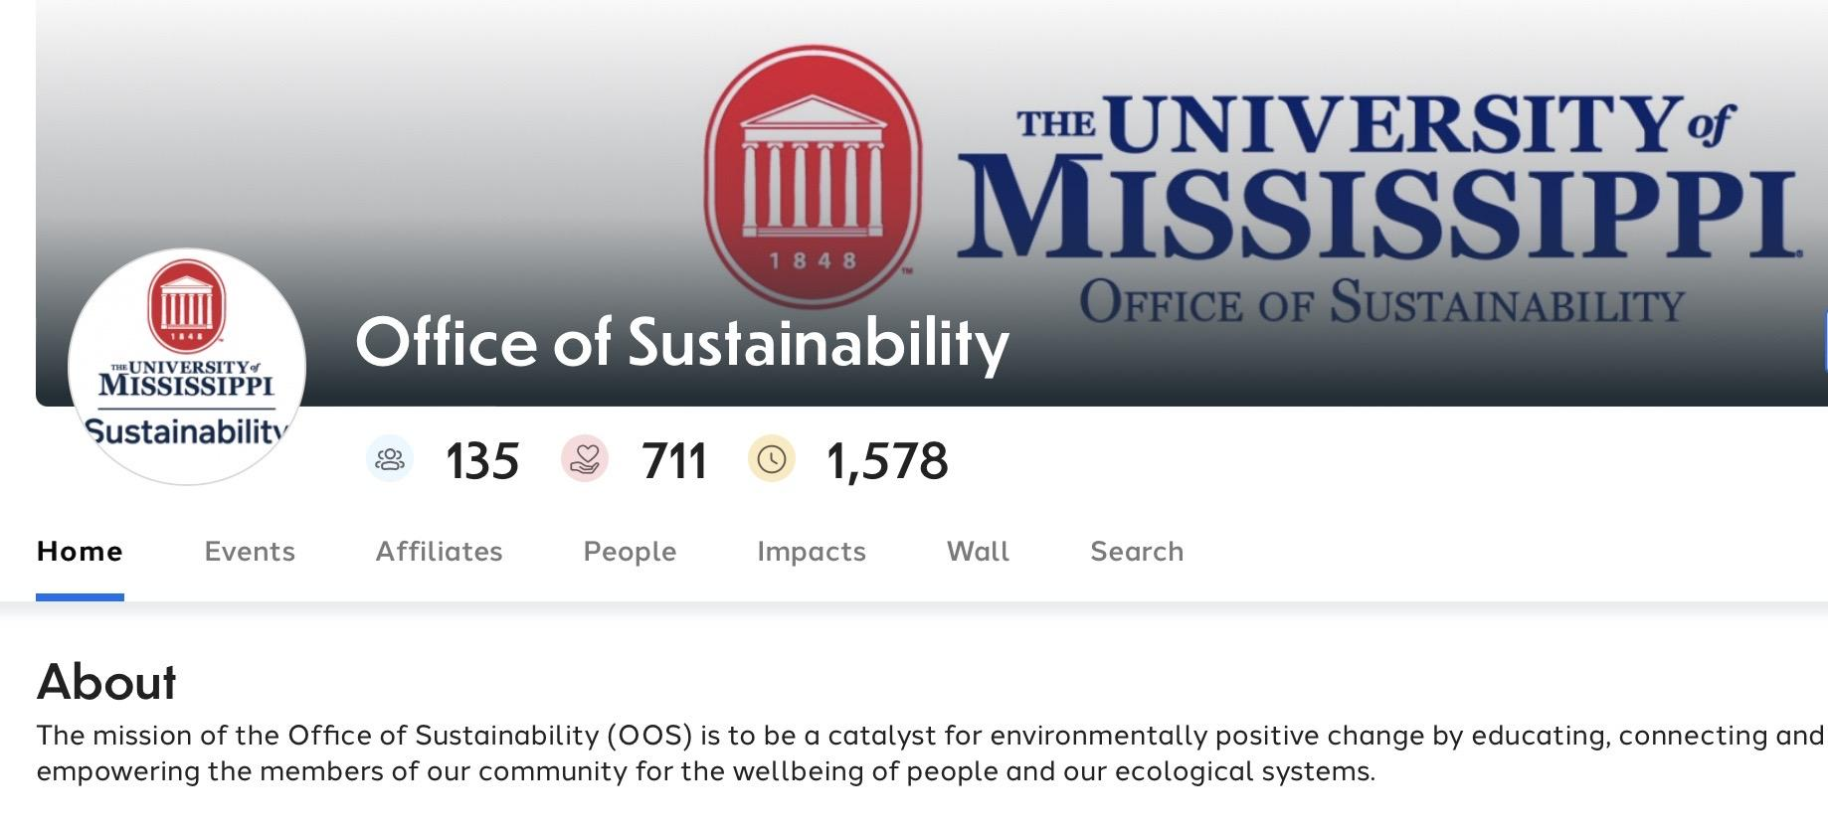
Volunteering

Slide 24
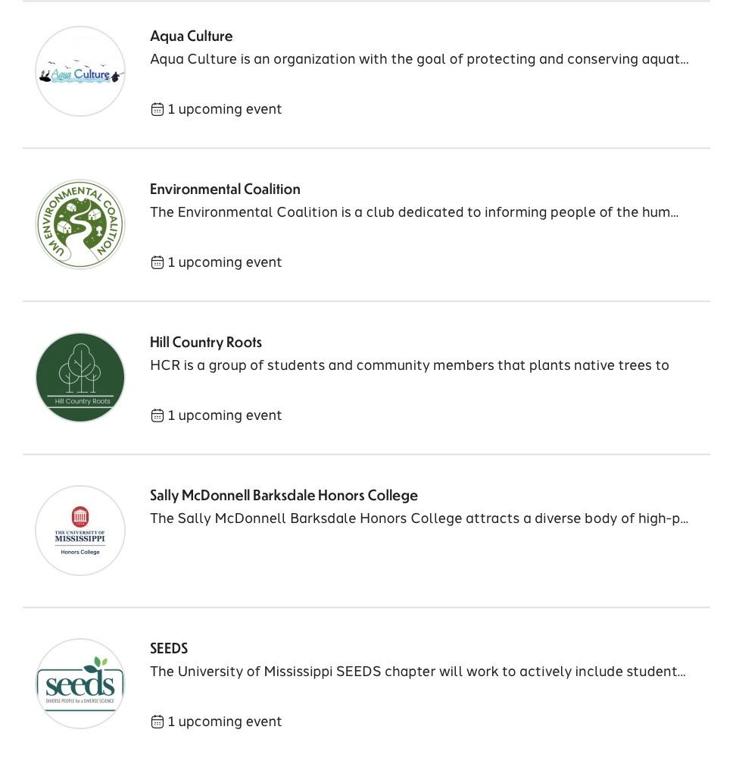

Slide 25

Volunteering
Oxford Community Market
Neighborhood Garden Project
Flower of Life Food Rescue Program
Farm-to-Campus Coordination
Weekly Oxford Community Market (Every Tuesday)

Slide 26
Local Employment
Oxford Community Market
Become a vendor
Work for local farms
North Mississippi VISTA Project
AmeriCorps VISTA core principles are poverty alleviation, capacity building, sustainable solutions, and community empowerment
Accepting Applications from August 6, 2025-August 3, 2026

Slide 27
Local Employment
Chicory Market
Full grocery experience focused on sustainably produced natural foods
Baking and Grab n’ Go Team Positions
Starting pay ranges from $15-18
Mulberry Lanes
Second-hand clothing, furniture, and more store
Looking for a clothing/textile/fashion enthusiast
Pay is dependent on experience

Slide 28
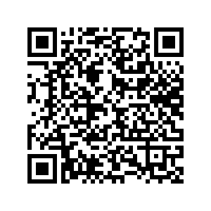
Questions?
https://docs.google.com/spreadsheets/d/1L2HwdNI9S0Umv4Wlx7mv40R5I34N_upiB17fqC4lRyQ/edit?usp=sharing

