Slide 1
Advanced Web Design Using Dreamweaver
http://www.olemiss.edu/webmaster/seminars.html
Robby Seitz
121 Powers Hall
rseitz@olemiss.edu
662-915-7822

Slide 2
Assumptions
You already understand HTML tags.
You can already use Dreamweaver.
You understand file name and folder location concepts.
You want to know more.

Slide 3
Cascading Style Sheets
HTML describes only the content of the document.
  <h1>, <p>, <li> describe the type of content, and not specifically how they should appear.
  The formatting of these elements by the browser is very limited, and inconsistent.
CSS was added to describe the layout of the HTML elements.
  Styles are normally saved in external files. These allow you to change the appearance of an entire site just by editing one single file.
  Zen Garden

Slide 4
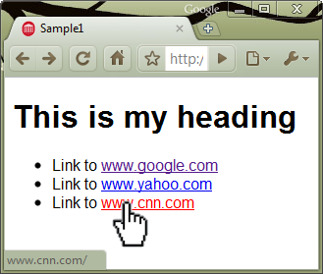
Cascading Style Sheets
Example: The link element
<a href="http://www.google.com">www.google.com</a>
Visited links are purple
Unvisited links are blue
Active links are red
The style for each of these is re-definable.

Slide 5
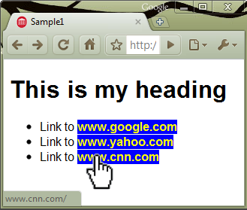
Cascading Style Sheets
Adding a style definition for the link element changes its appearance.
a {
font-weight: bold;
color: yellow;
background: blue;
text-decoration: none;
}

Slide 6
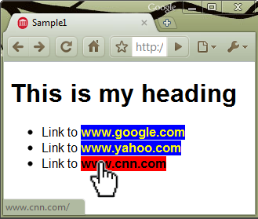
Cascading Style Sheets
CSS can also adjust only a particular aspect of some elements.
a {
font-weight: bold;
color: yellow;
background-color: blue;
text-decoration: none;
}
a:hover {
color: black;
background-color: red;
}

Slide 7
Cascading Style Sheets
“Cascading” refers to the precedence of definitions for a given element.
Browser default
External style sheet
Internal style section (inside the <head>)
Inline style (inside the HTML element)

Slide 8
Cascading Style Sheets
There are four ways to impose a style on HTML elements:
By element/tag name…
Make all paragraphs bold face.
p {font-weight: bold ;}
By class attribute…
Make anything with class="column" green.
.column {color: green ;}
By ID attribute…
Make the one element with id="header" all uppercase.
#header {text-transform: uppercase ;}
By style attribute…
Italicize this very element.
<p style="font-style: italic ;">

Slide 9
Cascading Style Sheets
Identifiers may also be combined.
p#myid {font-weight: bold;}
The one paragraph with id="myid" will be bold.
p.myclass {color: yellow;}
Any paragraph with class="myclass" will be yellow.
#mycontent .orange {color: orange;}
Any element with class="orange" inside the one element with id="mycontent" will be orange.

Slide 10
Cascading Style Sheets
Multiple identifiers can use the same style.
p.first, p.second, p.third {font-weight: bold;}
Any paragraphs with class="first", "second" or "third" will be bold.
table, td {border: 1px solid black;}
Every table and every table data cell will have black solid border 1 pixel wide.

Slide 11
Dynamic & Reusable Content
What content is generated automatically?
  Calendar events
  System-generated dates
  Anything requiring programming
Which parts of the page will appear on other pages? Create separate files for those parts and include them back into their locations. This allows you to make updates in only one place that impacts the entire site.
<!--#include virtual=“myfile.htm”-->

Slide 12
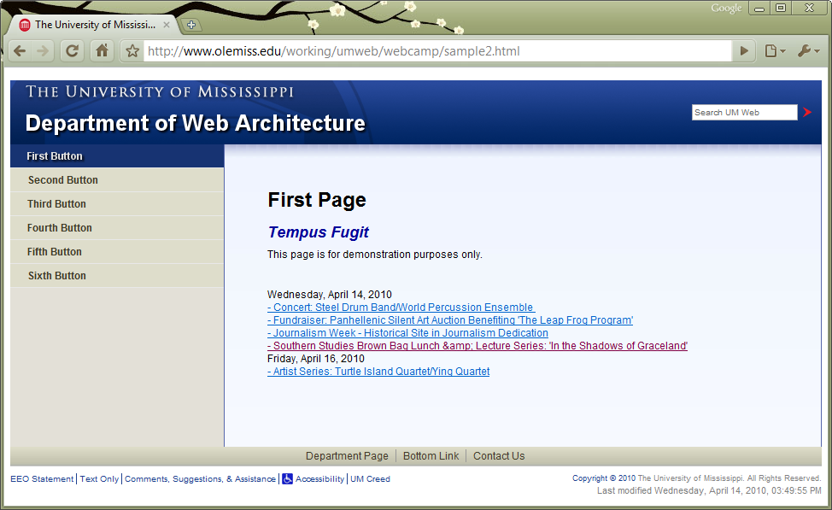
Deconstructing the page
Identify recurring parts
  Header
  Navigation
  Footer
  Stylesheet
  Javascript
Identify dynamic content
  Calendar events listing
  Date of last modification
www.olemiss.edu/working/maildemo/

Slide 13
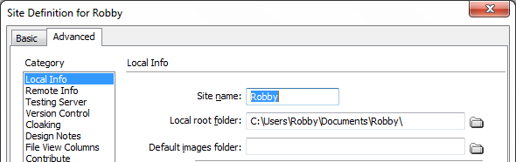
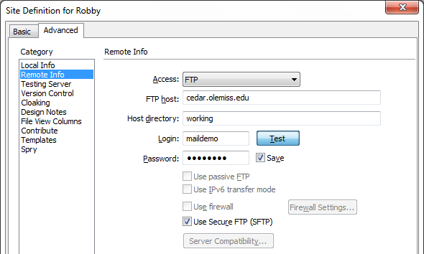
Start Your Dreamweavers!
Define your site:
  Site / New Site
  Select Advanced Tab
  Local Info…
    Site name: your name
    Local root folder:
    …/Documents/yourname
  Remote Info…
    Access: FTP
    FTP host: cedar.olemiss.edu
    Host directory: working
    Login: maildemo
    Password: ********
    Use Secure FTP (SFTP): Checked

Slide 14
Define new page name
Edit → Preferences → Code Format
Line break type: LF (Unix)
View Remote Files
Download the index.html file from the server
View Local Files
Change index.html to yourname1.html
Upload new file name to server
View in browser at www.olemiss.edu/working/maildemo/yourname1.html

Slide 15
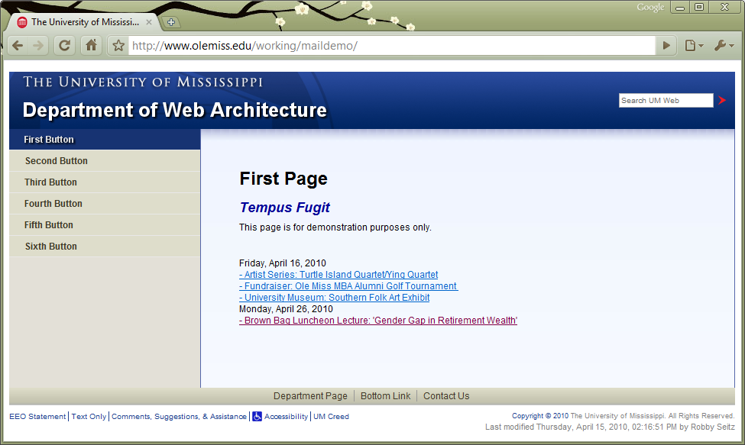
Customize it
Change “by” name and save/upload the page again.

Slide 16
Examine the CSS
Consider the left menu hover action
CSS
#leftcol a:hover {
background: #395494;
color: #dedede;
}
HTML
<body id=“pg1”>
…
<div id="leftcol">
<ul id="navigation">
<li id="head1"><a class="toplevel" href="index.html" id="li1">First Button</a></li>
<li id="head2"><a class="toplevel" href="index.html" id="li2">Second Button</a></li>
<li id="head3"><a class="toplevel" href="index.html" id="li3">Third Button</a></li>
</ul>
</div>

Slide 17
Customize the menu
Change the filenames to use your own filenames
<li id="head1"><a class="toplevel" href="yourname1.html" id="li1">First Button</a></li>
<li id="head2"><a class="toplevel" href="yourname2.html" id="li2">Second Button</a></li>
<li id="head3"><a class="toplevel" href="yourname3.html" id="li3">Third Button</a></li>

Slide 18
Disassemble the page
Put the Header, Navigation, and Footer in separate files
    yourname-head.htm
    yourname-menu.htm
    yourname-foot.htm
Include them in the original file:
<!--#include virtual=“yourname-head.htm”-->
(Note that this is a Server Side Include which your browser can only handle when viewing your page on a server.)

Slide 19
Disassemble the page
Put the contents of the <head> section in separate file yourname-meta.htm.
  <!--#include virtual="yourname-meta.htm"-->

Slide 20
Reassemble more pages
Change <body id="pg2"> and page name.
Save/upload as yourname2.html
Change <body id="pg3"> and page name.
Save/upload as yourname3.html
Once all pages are created and uploaded, browse your site and see how the pages relate to each other.

Slide 21
Reminders
You want to communicate URLs as succinctly as possible:
  Avoid using any uppercase characters – it matters!
  Avoid adding spaces to folder and file names. Spaces get converted to “%20” text, and browsers hate them.
Keep content current.
    If people wanted to see old information, they’d look on a printed piece.

